Slide 1
Module 2 Market Fundamentals

Slide 2
Module 2 – Introduction
In this module we will learn about
Global market Trade Flows
An introduction to crude oil
Basic introduction to refinery process
Overview of Freight and Logistics
Marine Logistics
ExxonMobil’s Molecule Management System MMS

Slide 3
Global Market Trade flows
The earth is round – everything ultimately mass balances
There are distinct regions of high production, regions of high processing and regions of high demand.
Typically molecules flow: production – process – end user
These supply patterns make economic and logistical sense
However no market is perfect, nor perfectly stable. These trade flows can be disrupted or even reversed.
There are numerous fundamentals driving crude flows:
Supply growth / disruptions
Demand growth / disruptions
Weather
Politics
Financial speculation
Shipping availability
Inventory / stock levels
Seasonality
…
North
America
Former
USSR
North West
Europe
Middle
East
South
America
Africa
Asia

Slide 4
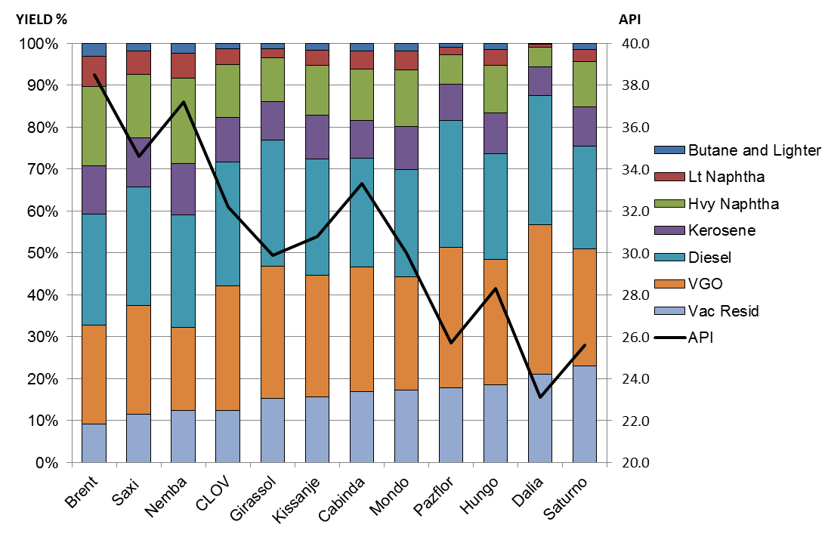
What is Crude Oil ? How are they different ?
Crude oil ia a collection of hydrocarbons, each with its own boiling point, and about 3% other impurities
It is primarily classified by its:
Density : Light or Heavy
Sulphur Content : Sweet or Sour
Generally the lighter and sweeter the crude, the more valuable it is to refiners
However its remaining composition is important as it will dictate its ease of processing and most importantly, its unique yield profile
The full characteristics of crudes are contained in its assay
Selection of crudes for specific refineries is highly complex:
Assay: its yields, its quality, its consistency
Availability and price
Its load port and logistics complexity
The demand for, and price of, specific refined products
Its match to the specific refinery assets and configuration
The other crudes that it will run with – the “crude slate”

Slide 5
Crude Oil Refining
There are four generic categories of refinery process:
Fractionation
Separation of hydrocarbons by physical means (boiling point)
Typically atmospheric and/or vacuum distillation towers
Products condense out when the temperature drops below their boiling point
Simple refineries that just have fractionation units are called vac skimming refineries
Conversion
Transformation of hydrocarbons by chemical means
Catalytic Cracking –splitting long chain molecules into shorter chain molecules
Polymerisation – joining short chain molecules into long chain molecules
Reforming/isomerization – upgrading the octane of feedstock using catalysts
Refineries that have a network of conversion units are called complex refineries
Treating
Targeted removal of the inherent impurities in crude oil
Blending
The combining of intermediate refinery streams, specific blend components like bio fuels, to make specific finished products
Refinery margins are set by :
Investment in the right assets – degree of refinery complexity and integration (chemicals / power)
Selection of the crude slate
Management of the running costs
Alignment of the refined product output with the market demand, in the highest value permutation
Calculating the lowest cost crude slate which gives the highest value refined products, within the constraints of the specific refinery assets, is highly complex and done by linear programs
Gas & LPG
Naphtha
Kerosene
Diesel
Gasoil
Fuel Oil
Bitumen
600 deg C

Slide 6
Freight and Logistics
There are four generic methods of oil movement:
Marine - oil tanker & barge
Pipeline
Rail Car
Tank Truck
All have inherent advantages and disadvantages
In oil contracts the mode of delivery is described by a standard set of international sales terms published by the International Chamber of Commerce, called INCO Terms.
These include:
ITT = In tank transfer
DAP = Delivered at place ex ship (replaced the old DES in 2010, a lot of people still use DES)
FOB = Free on board
CFR = Cost and Freight
CIF = Cost, insurance and freight
Notes:
LINE 2: All have inherent advantages and disadvantages – what might those be ?
Do you understand each term ?
In the context of a crude oil delivery, discuss when each might be used and why ?
How do INCO terms relate to GT&Cs ?
Why do traders need to be very precise about INCO terms ? What are the commercial pitfalls ?

Slide 7
Marine Logistics
Types of vessel typically used to move crude oil:
VLCC 260,000 MT roughly 3x afras
Suez 170,000 MT roughly 2x afras
Afra 85,000 MT
Types of charter contract
Spot or Contract of Afreightment
Time Charter
Bareboat
Vessel Screening and Approval
All vessels chartered for ExxonMobil use MUST be screened and specifically approved
It is a vital, non discretionary, element of all trading deal recaps
Calculating Freight Rates: Flat Rate and World Scale (WS)
WS is a shipping market index and it is the mechanism that the shipping markets use to calculate freight costs
WS is reported each day by agencies like Platts and Argus in exactly the same way as oil prices
The WS quotes are for fixed routes, standard vessel sizes and type of oil (clean or dirty)
A WS of 100 is based on a “normal” market, below 100 and the freight market is weak and above 100 and it is strong.
The FR is a standard price, in dollars, from port A to port B
The rates are set annually and are based on the average freight market of the previous year and the cost of bunkers
WS multiplied by FR gives you a lump sum. This lump sum, divided by the cargo size, is the freight rate in $/Bbl.
Example: A ship is quoted at WS 155 for voyages from the Med to NWE. The FR is 1.25 $/Te, so the voyage cost is 155*1.25=1.94

Slide 8
Marine Logistics
Some examples for us to work through and discuss …
You have been quoted a price “dtd +1.35 $/bbl, DES Augusta with onward freight at cost” for a suez of CPC Blend loading at Ceyhan in the black sea, what is the final cost, delivered to Rotterdam ?
Suez carrying 1000 kbbls WS=85; Flat rate Ceyhan-Augusta is 1.01 $/bbl and Ceyhan-Rotterdam is 1.99 $/bbl
How much extra should the afra price at Augusta be relative to a Suez price at Augusta in the above example ? What is the difference in delivered cost ($/bbl) between an afra and a suez for a voyage from Ceyhan in the black sea to Rotterdam ?
Suez WS=85 and Afra WS=105
Is it better to 2x port discharge a VLCC or charter 2x suez vessels for a voyage from Sidi Kerir to Port Jerome and Rotterdam
Flat Rates: SK-Rotterdam - 1.73 $/bbl; SK-Port Jerome – 1.83 $/bbl. Rotterdam-Port Jerome – 0.18$/bbl. VLCC WS=33 and SuezWS=55
Marine Logistics …… what could possibly go wrong ? – well, practically everything !
Vessel fails its EM inspection
The counter party, who is organising the freight “at cost” (we bought DES), quotes us a WS rate that is way higher than the market
Oil is unavailable at the load port – production issues, quality problems ….
The berths are congested
The vessel is late arriving from its previous voyage and misses its laycan
Delays in the Turkish Straits, out of the Black Sea
Weather
Ice (ice cleared vessels)
Delays at discharge – waiting for a pilot, berth congestion, receipt line clearing, no ullage at receipt tank
Notes:
How do traders work with Marine Ops to manage the uncertainties associated with freight and logistics ?

Slide 9
For Reference : Some Marine Logistics Terms
Charter Party is a marine contract by which a ship owner agrees to lease and the charterer agrees to hire an entire ship (or all/part of the cargo space) to carry a cargo for an agreed sum, under specific conditions
Laydays is the period of time, described in the charter party, during which the vessel owner must tender his ship for loading
Laycan is short for lay-days and cancelling-days. If a vessel does not present within the specified dates then the charterer can cancel
Demurrage is the extra time used by a vessel for either loading or discharging.
In the charter party a vessel will be given a set time for these operations, say 36 hours.
If it takes 48 hours then the extra 12 hours is charged at a pre agreed rate
Most claims have to be made by a pre agreed date, typically 60 or 90 days after the event (after that there is a time bar)
Overage is essential surplus cargo over the contracted amount (sometimes it is possible to put more on the vessel). The more cargo on the ship the lower the unit freight rate. How the benefit is allocated between vessel owner and charterer is defined in the charter party
Deadfreight is in some ways the opposite of overage, it is non utilisation of the cargo carrying capacity on the vessel.
Lightering is the process of transferring a larger cargo from a vessel to one of a number of smaller vessels
Backhaul is the movement of a cargo on the return leg of a voyage
Placing a vessel on subs means “reserving” a vessel for a limited period – literally “subject to final approval”
FFA is a Freight Futures Agreement. It is a paper contract for shipping where a freight price for a future voyage is agreed at today’s value. It can be used to lock in freight costs.

Slide 10
Refresh : Value Chain – Trading Interface
Earlier, we talked about the value chain and where trading fits in:
Wellhead
Customer
Trade & Schedule Crude and Other Feedstocks
Transfer of Crude & Feedstocks
to Refinery
Refinery Optimization
Trade & Schedule Products
Transfer of
Products from Refinery
to Terminal
Terminal
Loading
Global
Crude and Feedstock
Market
Global
Products
Market
So its worth taking 5-10 mins just to talk about how that interface is managed :
How do we establish what our own value chain (refineries) requirements are
What imbalance will then need to be managed

Slide 11
System Coverage – Economic modelling / crude signals / execution
Long-term price-set
Near-term price-set
“PPFV-High” price-set
PPFV price-set
Run-month M
M+4
M+3
M+2
M+1
Oct
Nov
Dec
Jan
Feb
Assemble model inputs..
Including Crude and Product Price outlook meetings
Circuit Economist develops Strategy – reviews with Optimisers, Refinery Co-ordination and Traders
Site Crude Scheduler develops “schedule” for replenishment in ORION based on base crude slate / run-rate
First pass signals available (typically on HOLD, or “OP” in GOM terms)
Specific Economics can be run at this stage if needed (e.g. WAF, ECAN)
Revised price / demand outlook
Update strategy
Prompt focus on AG economics
With AG strategy clear, Circuit Economist commences detailed economics for remaining crude.
Based on above, site Crude scheduler revises schedule, updating Signals.
Signals updated (and now typically moving to FIRM, or “SIG” in GOM terms)
Optimiser / Trader interaction on coverage and Reoptimisation – cross-desk discussion.
Continue to review validity of strategy, updating economics and signals
Revised price / demand outlook
Update strategy with crude coverage already done
Focus on remaining coverage – including Agility around marginally economic crude runs etc.
Focus on Regional inter-site transfers / non-crude feedstocks / blendhubs / product strategies
Finalise Signals / finalise coverage (and now typically moving to “COV” when the crude is bought and “SCH” when the ship/logistics have been arranged)
Site Economist and schedulers fine-tune plans for Operation to execute
Notes:
PPFV … product price forecast value

Slide 12
Trading in “Windows” as we move through M+4 to M
Decision making relies on understanding the values of your alternates
Valuation is not always straightforward, as crudes:
Trade at different times
Have different delivery lead times
Strategic decision making, across numerous constantly dynamic markets, is critical
10
9
8
7
6
5
4
3
2
1
North Sea Grades
C P C
West African Grades
Saudi Grades
FSU / Urals Grades
North African Grades
Negotiating Window
Loading date
Sailing Time
Requirement
6
Weeks ahead of requirement
M+3
M+2
M+1
M
run month
Timing when to make your move in the market is highly valuable
to do that you must have the best data and be inclusive & integrated

Slide 13
Module 2 – What have we learnt ?
How the global crude market trade flows work and when they don’t – introducing arbitrage
An introduction to crude oil, how its categorised and valued
A very basic introduction to the refinery process
Overview of Freight and Logistics
A bit more depth into Marine Logistics, focusing on how chartering works and how freight costs are calculated
How MMS drives our system demand and how it interacts with trading

